Slide 1
Polymers
Dr. Ranjit Kumar
Department of Chemical Engineering
Email: ranjit.kumar@snu.edu.in

Slide 2
POLYMERS
Polymers are macromolecules formed by linking together of a large number of small molecules called monomers. The polymers are giant molecules with high molecular masses. For example, the monomer ethylene gets linked with many other ethylene molecules to form polyethylene, or large number of vinyl chloride molecules combines to form polyvinyl chloride.
The single repeating unit is called as monomer, and the resultant high molecular weight compound is called as polymer.

Slide 3
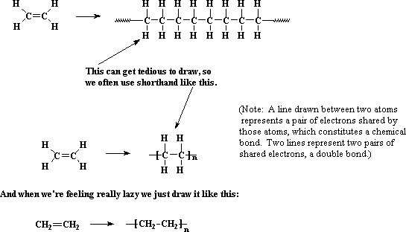
POLYMERS

Slide 4
POLYMERS
Based on physical property, the polymers with high degree of polymerization are known as high polymers while those having comparatively low degree of polymerization are known as oligopolymers. The molecular weights of polymers are generally in the range of 5000 to 200,000. Hence, these are also known as macromolecules.
The total number (n) of single monomer units combined together to form a polymer is known as degree of polymerization (DP). DP affect physical properties of polymers.

Slide 5
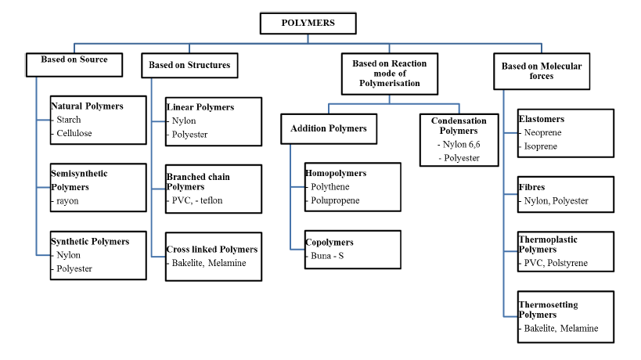

Slide 6
Repeat Unit of Common Polymers

Slide 8
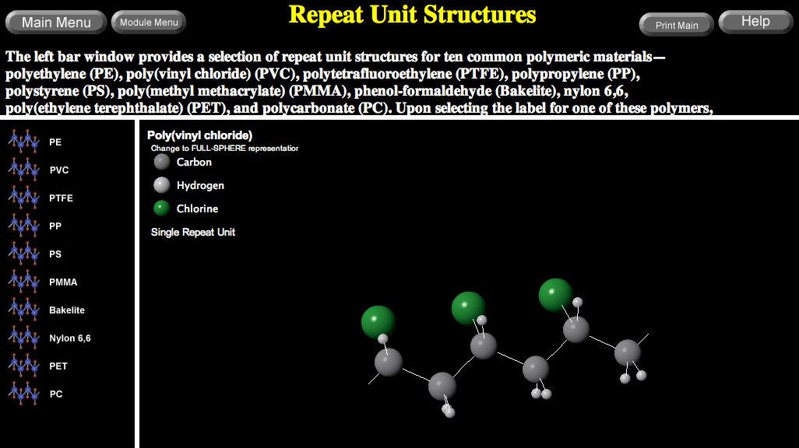
VMSE: Polymer Repeat Unit Structures
Manipulate and rotate polymer structures in 3-dimensions
https://drbuc2jl8158i.cloudfront.net/VMSE/index.html

Slide 9
POLYMERIZATION
The reaction of monomers to form a polymer is known as polymerization. The polymers are formed mainly by
i) Addition polymerization (Chain polymerization).
ii) Condensation polymerization (Step polymerization).

Slide 10
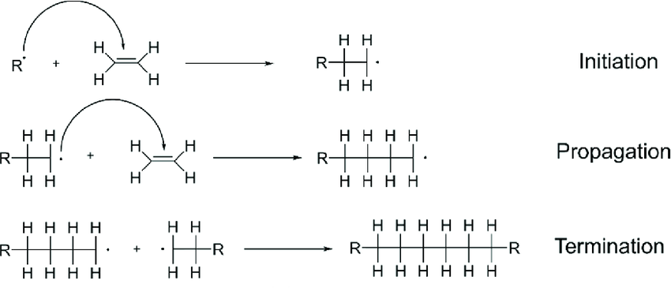
Addition Polymerization Mechanism
Addition polymerization was defined as the reaction where small chain monomers are converted to long chain polymers without the elimination of any small atoms or molecules during the course of reaction. Ex.- Polyethylene, Polystrene, Polyetetrafluoroethylene (Teflon), Polyvinylchloride, etc.

Slide 11
POLYMERIZATION
ii) Condensation Step Polymerization-
The monomers having certain functional groups such as -OH, - COOH, - NH₂ etc. show the tendency to undergo polymerizations by the elimination of one molecule of a simple by-product such as H₂O, HCl, salt or alcohol etc. Unlike addition / chain polymerizations, polymer loses simple molecules at every combination, as a result does not have exact multiple number of monomer units.

Slide 12
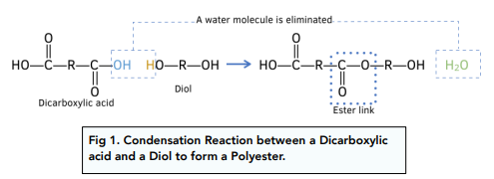
Mechanism

Slide 13
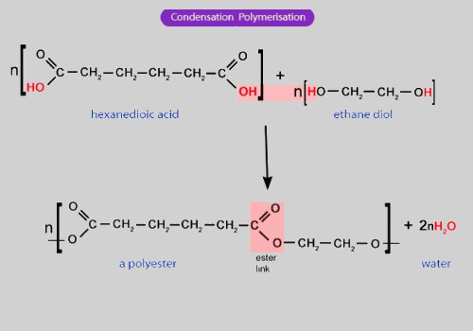
POLYMERIZATION

Slide 14
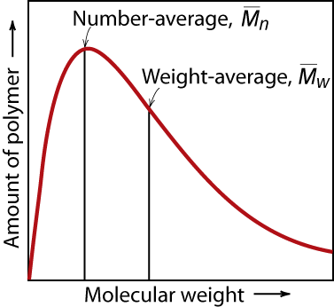
MOLECULAR WEIGHT DISTRIBUTION
Adapted from Fig. 14.4, Callister & Rethwisch 8e.
M_{i} = mean (middle) molecular weight of size range i
x_{i} = number fraction of chains in size range i
w_{i} = weight fraction of chains in size range i
Notes:
Simple for small molecules
All the same size
Number of grams/mole
Polymers – distribution of chain sizes

Slide 15
Degree of Polymerization, DP
DP = average number of repeat units per chain
DP = 6
Chain fraction
mol. wt of repeat unit i

Slide 16
Polydispersity Index
It is the ratio of weight average M.W and number average M.W. ie Mw/Mn
If value of polydispersity index is 1, polymer is identified as monodispersed, where consisting molecules have identical mass. If value is 2, polymer is identified as polydispersed, where consisting molecules have different mass.

Slide 17
Q. Assume that the molecular weight distributions shown in Table below are for poly(vinyl chloride). For this material, compute (a) the number-average molecular weight, (b) the degree of polymerization, and (c) the weight-average molecular weight.
(a)
To determine the degree of polymerization, it is first necessary to compute
the repeat unit molecular weight. For PVC, each repeat unit consists of two carbon atoms, three hydrogen atoms, and a single chlorine atom. Furthermore, the atomic weights of C, H, and Cl are, respectively, 12.01, 1.01, and 35.45 g/mol. Thus, for PVC,
m = 2(12.01 g/mol) + 3(1.01 g/mol) + 35.45 g/mol = 62.50 g/mol
(b)

Slide 18
(c)

Slide 19
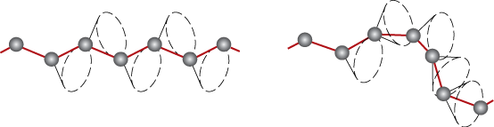
Polymers – Molecular Shape
Molecular Shape (or Conformation) – chain bending and twisting are possible by rotation of carbon atoms around their chain bonds
note: not necessary to break chain bonds to alter molecular shape

Slide 20
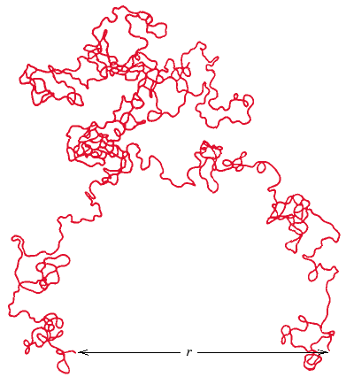
Chain End-to-End Distance, r

Slide 21
Molecular Structures for Polymers
secondary
bonding
Linear
B
ranched
Cross-Linked
Network
polyethylene,
poly(vinyl chloride), polystyrene, poly(methyl methacrylate), nylon, and the fluorocarbons.
high-density polyethylene (HDPE) is primarily a linear polymer, whereas low density
polyethylene (LDPE) is branched
Many of the rubber elastic materials are crosslinked
The epoxies, polyurethanes,
and phenol-formaldehyde belong to this group

Slide 22
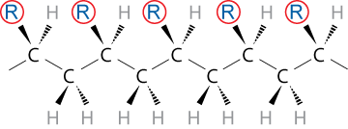
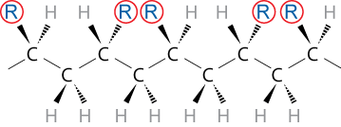
Tacticity
Tacticity – stereoregularity or spatial arrangement of R units along chain
isotactic – all R groups on same side of chain
syndiotactic – R groups alternate sides

Slide 23
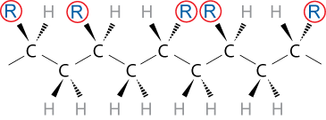
Tacticity (cont.)
atactic – R groups randomly positioned

Slide 24
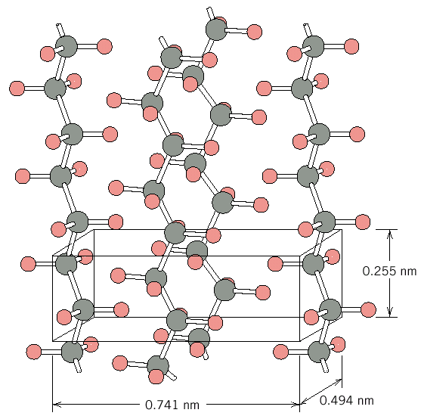
Crystallinity in Polymers
Ordered atomic arrangements involving molecular chains
Crystal structures in terms of unit cells
Polymers are never 100% crystalline
Example shown
polyethylene unit cell

